Slide 1
CHGM-141
General and Analytical Chemistry I
Lecture 22
(Ch.8) with Dr. Bailey
Thermochemical Equation, Enthalpy Changes
Hess’s law
Standard Enthalpies of Formation
Calculating Enthalpy Changes Using Bond Dissociation Energies
Fossil Fuels, Fuel Efficiency

Slide 2

Endothermic or Exothermic?
H₂(g) + O₂ (g)→ 2H₂O(g)
Endothermic
Exothermic
10
0
of
5

Slide 3
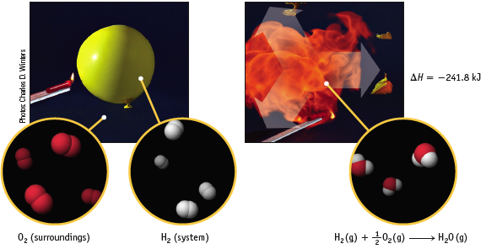
USING ENTHALPY
Consider the formation of water
H₂(g) + 1/2 O₂(g) → H₂O(g) + 241.8 kJ
Exothermic reaction — heat is a “product” and ∆H = – 241.8 kJ
½ an Oxygen?...

Slide 4
Why can we have ½ an Oxygen?
In thermochemistry we are always dealing with moles of reagents, by definition.
Hence we are justified in using fractions
H₂(g) + 1/2 O₂(g) → H₂O(g) ∆H = – 241.8 kJ

Slide 5

  RECAL: a state function is a mathematical function or property whose result only depends on the initial and final conditions, not on the process (path) used to arrive at that state.
Altitude is a state function
  My change in Altitude upon traveling to Denver, CO is the same whether I drive there or fly there.
Enthalpy is a state function
  H₂(g) + 1/2 O₂(g) → H₂O(l) ∆H˚ = -286 kJ
Hess’ Law relies on Enthalpy being a state function.
Let’ consider this reaction as an Example of HESS’S LAW…

Slide 6
USING ENTHALPY – Hess’ Law
Making H₂O(l) from H₂ involves two steps.
H₂(g) + 1/2 O₂(g) → H₂O(g) + 242 kJ
H₂O(g) → H₂O(l) + 44 kJ
-----------------------------------------------------------------------
H₂(g) + 1/2 O₂(g) → H₂O(l) + 286 kJ
This is Example of HESS’S LAW —
If a rxn. is the sum of 2 or more others, the net ∆H is the sum of the ∆H’s of the other rxns.
We can make liquid water from Hydrogen gas in two pathways (in a single step or in two steps) but that the enthalpy change from each pathway is the same
Hess’s Law
& Energy Level Diagrams…

Slide 7
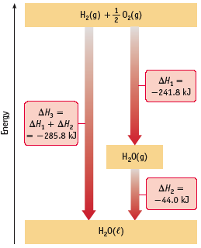
Hess’s Law
& Energy Level Diagrams
An enthalpy diagram is a graphical representation of alternate pathways between initial and final states
Forming H₂O can occur in a single step or in a two steps.
∆H_{total} is the same no matter which path is followed.

Slide 8

Enthalpy changes for reactions can be calculated by algebraic summation
This is called Hess’s Law:
The value of ΔH for any reaction that can be written in steps equals the sum of the values of ΔH for each of the individual steps.
Enthalpy changes may be calculated using only a few simple rules…

Slide 9

Enthalpy is an extensive property.
The enthalpy change of a reaction depends on how much stuff you have.
2x as much H₂ and O₂ will give you an explosion twice as large with twice as much energy being released.
H₂(g) + O₂ (g)→ 2H₂O(g)
    If all the coefficients of an equation are multiplied or divided by the same factor, the value of the enthalpy change must likewise be multiplied or divided by that factor:
CH_{4(g)} + 2O_{2(g)} CO_{2(g)} + 2H₂O_{(l)} ∆H = -890 KJ
2CH_{4(g)} + 4O_{2(g)} 2CO_{2(g)} + 4H₂O_{(l)} ∆H = -1780 KJ

Slide 10
The enthalpy change for a reaction is equal in magnitude but opposite in sign to ∆H for the reverse reaction.
CH_{4(g)} + 2O_{2(g)} CO_{2(g)} + 2H₂O_{(l)} ∆H = -890 KJ
CO_{2(g)} + 2H₂O_{(l)} CH_{4(g)} + 2O_{2(g)} ∆H = +890 KJ
CH_{4(g)} + 2O_{2(g)}
∆H₁ = -890 KJ
∆H₂ = +890 KJ
CO_{2(g)} + 2H₂O_{(l)}

Slide 11
3. The enthalpy change for a reaction depends on the state of the reactants and products.
It takes energy to evaporate a substance. If we required water vapor, more energy would be required to evaporate any liquid water produced and so the net heat given off would be less.
2H₂O_{(l)} 2H₂O_{(g)} ∆H = +88kJ
∆H = -890kJ + 88kJ = -802kJ
CH_{4(g)} + 2O_{2(g)} CO_{2(g)} + 2H₂O_{(l)} ∆H = -890 KJ
CH_{4(g)} + 2O_{2(g)}
∆H = -890kJ
∆H = -802kJ
CO_{2(g)} + 2H₂O_{(g)}
CO_{2(g)} + 2H₂O_{(l)}
∆H = +88kJ
  Note: Formulae canceled from both sides of an equation must be for substances in identical physical states.

Slide 12

H₂(g) + 1/2 O₂(g) → H₂O(g)
∆H˚ = -242 kJ
2 H₂(g) + O₂(g) → 2 H₂O(g)
∆H˚ = -484 kJ
H₂O(g) → H₂(g) + 1/2 O₂(g)
∆H˚ = +242 kJ
H₂(g) + 1/2 O₂(g) → H₂O(liquid)
∆H˚ = -286 kJ

Slide 13

(1)
½ N₂ (g) + O₂ (g) → NO₂ (g) ΔHº = +33.8 kJ
½ N₂ (g) + ½ O₂ (g) → NO (g) ΔHº = +90.37 kJ
NO(g) + ½ O₂ (g) → NO₂ (g) ΔHº = ?
We just have to determine how to sum these reactions to get the overall reaction of interest
Draw an enthalpy diagram for the formation of NO₂ from its elements by two pathways: first , from its elements and second, by a two step process, also from the elements.
Calculate the unknown standard enthalpy change.
(2)

Slide 14

(1)
½ N₂ (g) + O₂ (g) → NO₂ (g) ΔHº = +33.8 kJ (1)
½ N₂ (g) + ½ O₂ (g) → NO (g) ΔHº = +90.37 kJ (2)
NO(g) + ½ O₂ (g) → NO₂ (g) ΔHº = ? (1 – 2)
(2)
Draw an enthalpy diagram for the formation of NO₂ from its elements by two pathways: first , from its elements and second, by a two step process, also from the elements.
Calculate the unknown standard enthalpy change.
NO(g) + ½ O₂ (g)
ΔHº = -56.6 kJ
(2)
ΔHº = +90.37 kJ
NO₂ (g)
(1)
ΔHº = 1-2 = -56.6 kJ
ΔHº = +33.8 kJ
We just have to determine how to sum these reactions to get the overall reaction of interest
½ N₂ (g) + O₂ (g)

Slide 15

½ N₂ (g) + O₂ (g) → NO₂ (g) ΔHº = +33.8 kJ
½ N₂ (g) + ½ O₂ (g) → NO (g) ΔHº = +90.37 kJ
NO(g) + ½ O₂ (g) → NO₂ (g) ΔHº = ?
Alternatively...
½ N₂ (g) + O₂ (g) → NO₂ (g) ΔHº = +33.8 kJ
NO (g) → ½ N₂ (g) + ½ O₂ (g) ΔHº = -90.37 kJ
NO(g) + O₂ (g) + ½ N₂ (g) → NO₂ (g) + ½ N₂ (g) + ½ O₂ (g) ΔHº = ?
NO(g) + ½ O₂ (g) → NO₂ (g) ΔHº = 1-2 = -56.6 kJ
1
2
1
-2
½
We just have to determine how to sum these reactions to get the overall reaction of interest

Slide 16

Potential Energy stored in chemical bonds can be converted to kinetic energy. Kinetic energy is manifested as heat.
So how can we calculate the heat released from these chemical bonds?
1. Experimentally: we use calorimetry. Calorimetry combined with the first law of thermodynamics allows us to quantify heat energy.
We work at constant pressure in chemistry and so we can link the heat transfer at constant pressure to the energy change in the chemical system. We can measure the enthalpy change of the system.
2. Inferentially through Hess’s law:
By recognizing that Enthalpy is a state function, we can use Hess’ law to predict enthalpy changes without having to run awkward thermochemical experiments. Hess’ law is a valuable tool in thermochemistry.
3. We now turn to a third and more convenient way:
From tabulated Standard Enthalpies of Formation (So Hess’ Law restated…)

Slide 17
When an enthalpy change reported, it is necessary to specify:
the physical state of reactants and products
the pressure
temperature
To ensure that all measurements are reported in the same way so that different reactions can be compared, a set of conditions called the thermodynamic standard conditions has been defined
Measurement made under these standard conditions are indicated by addition of the subscript ° to the symbol
A standard enthalpy of reaction is indicated by the symbol ΔH°
Next: standard conditions…
standard state…

Slide 18

the standard state is the state of a material at a defined set of conditions
  pure gas at exactly 1 atm pressure
  pure solid or liquid in its most stable form at exactly 1 atm pressure and temperature of interest
    usually 25°C
  substance in a solution with concentration 1 M
The standard state of an element or compound is the natural state of that element or compound at these standard conditions
  Eg: Carbon is Graphite
  Carbon is a solid
  Oxygen is a gas
  Water is a liquid.

Slide 19
1.Standard enthalpy (heat) of reaction is value of enthalpy change occurring under standard conditions involving the actual number of moles specified the equation coefficients
An enthalpy change for standard conditions is denoted ΔH°
Example:
the thermochemical equation for the production of ammonia from it elements at standard conditions is:
Huge database of standard enthalpy changes…

Slide 20
  2.The standard heat of combustion is the amount of heat released when 1 mol of a fuel completely burns in pure oxygen gas with all products brought to 25 °C and 1 atm
  Standard heats of combustion are always negative and produce water in liquid form
Example:
Enthalpies of Formation…

Slide 21
3. The standard enthalpy of formation, ΔH_{f}°, is the enthalpy change for the reaction forming 1 mole of a pure compound from its constituent elements
  the elements must be in their standard states
  the ΔH_{f}° for a pure element in its standard state = 0 kJ/mol
    by definition
Example:
  Note: since the definition requires 1 mole of compound be made, the coefficients of the reactants may be fractions
    These are the values most commonly used to calculated standard enthalpy changes for reactions…
Example..

Slide 22
Writing Formation Reactions
Write the formation reaction for CO(g)
Example..
the formation reaction is the reaction between the elements in the compound, which are C and O
C + O → CO(g)
the elements must be in their standard state
  there are several forms of solid C, but the one with ΔH_{f}° = 0 is graphite
  oxygen’s standard state is the diatomic gas
C(s, graphite) + O₂(g) → CO(g)
the equation must be balanced, but the coefficient of the product compound must be 1
  use whatever coefficient in front of the reactants is necessary to make the atoms on both sides equal without changing the product coefficient
C(s, graphite) + ½ O₂(g) → CO(g)

Slide 23
Which equation below defines the standard molar enthalpy of formation of gaseous methanol CH₃OH?
10
CH₄(g) + 1/2 O₂(g) → CH₃OH(g)
C(s) + 2 H₂(g) + 1/2 O₂(g) → CH₃OH(g)
CO(g) + 2 H₂(g) → CH₃OH(g)
H₂O(g) + C(s) + H₂(g) → CH₃OH(g)

Slide 24
Which equation below defines the standard molar enthalpy of formation of gaseous methanol CH₃OH?
10
CH₄(g) + 1/2 O₂(g) → CH₃OH(g)
C(s) + 2 H₂(g) + 1/2 O₂(g) → CH₃OH(g)
CO(g) + 2 H₂(g) → CH₃OH(g)
H₂O(g) + C(s) + H₂(g) → CH₃OH(g)

Slide 25
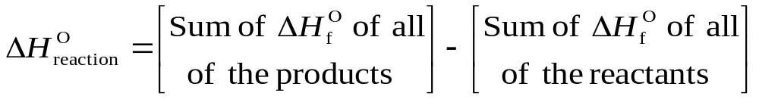
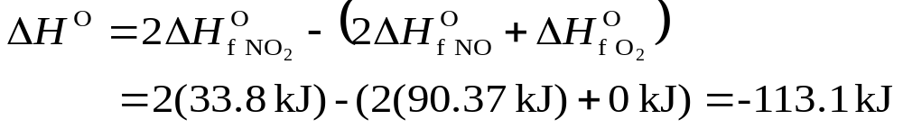
Hess’s law can be restated in terms of standard enthalpies of formation:
  or
  ΔH°_{reaction} = Σ n ΔH_{f}°(products) - Σ n ΔH_{f}°(reactants)
  − Σ means sum
  n is the coefficient of the reaction
  Example: Calculate the enthalpy of reaction for
  2NO(g)+O2(g)→2NO2(g)
  Solution:

Slide 26
Calculating Enthalpy Changes Using Bond Dissociation Energies
Bond Dissociation Energy:
The amount of energy that must be supplied to break a chemical bond in an isolated molecule in the gaseous state and is thus the amount of energy released when the bond forms.
        or
Standard enthalpy changes for the corresponding bond-breaking reactions.
For the reaction X – Y → X + Y ΔH° = D = Bond dissociation energy
Notes:
Chapter 8: Thermochemistry: Chemical Energy
Copyright © 2010 Pearson Prentice Hall, Inc.
The first definition came from Chapter 5 and the second one from this chapter.

Slide 27
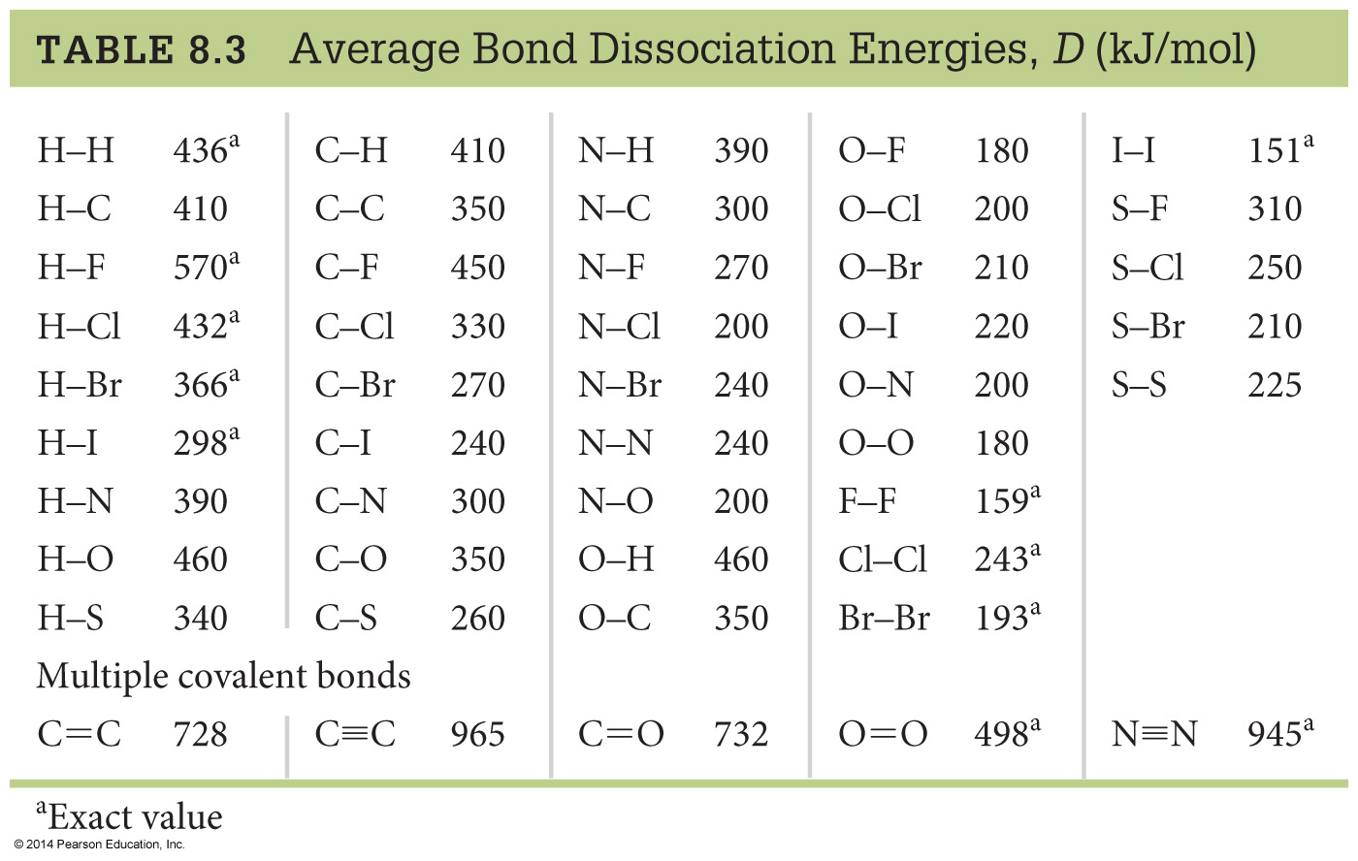
Calculating Enthalpy Changes Using Bond Dissociation Energies
Notes:
Chapter 8: Thermochemistry: Chemical Energy
Copyright © 2010 Pearson Prentice Hall, Inc.
Note that all the bond dissociation energies are positive.

Slide 28
Calculating Enthalpy Changes Using Bond Dissociation Energies
H₂(g) + Cl₂(g)
2 HCl(g)
∆H°= D(Reactant bonds) - D(Product bonds)
∆H°= (D_{H-H} + D_{Cl-Cl}) - (2 D_{H-Cl})
∆H°= [(1 mol)(436 kJ/mol) + (1mol)(243 kJ/mol)] -
(2mol)(432 kJ/mol)
= -185 kJ
“Reactants – products”! This is opposite that for enthalpies of formation.
All BDEs are positive. Add the values for the ones you have to break (reactants) and subtract the values for the ones you make (products; forming bonds releases energy).
Notes:
Chapter 8: Thermochemistry: Chemical Energy
Copyright © 2010 Pearson Prentice Hall, Inc.
Reactants - products! This is opposite that for enthalpies of formation.
All BDEs are positive. Add the values for the ones you have to break (reactants) and subtract the values for the ones you make (products; forming bonds releases energy).
This compares well to 2x(standard enthalpy of formation for HCl) = -184.6 kJ/mol

Slide 29
Heats of Combustion and Fossil Fuels
Let’s come back..
Fossil fuels (oil, natural gas, coal)
CH₄(g) + 2 O₂(g)
CO₂(g) + 2 H₂O(l)
∆H_{c} = [∆H_{f} (CO₂(g)) + 2 ∆H_{f} (H₂O(l))] - [∆H_{f} (CH₄(g))]
= [(1 mol)(-393.5 kJ/mol) + (2 mol)(-285.8 kJ/mol)] -
[(1 mol)(-74.8 kJ/mol)]
= -890.3 kJ
The amount of energy released on burning a substance is called its Heat of combustion, or
Combustion enthalpy, ∆H_{c}
Notes:
Chapter 8: Thermochemistry: Chemical Energy
Copyright © 2010 Pearson Prentice Hall, Inc.

Slide 30
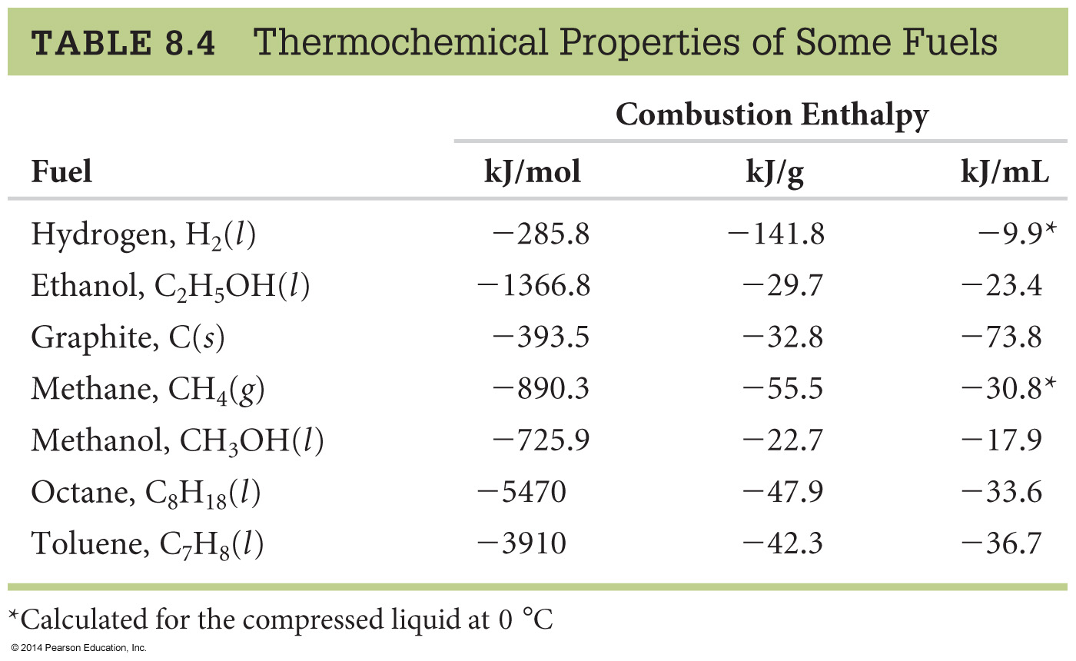
Fossil Fuels, Fuel Efficiency, and Heats of Combustion
CH₄(g) + 2 O₂(g)
CO₂(g) + 2 H₂O(l)
Notes:
Chapter 8: Thermochemistry: Chemical Energy
Copyright © 2010 Pearson Prentice Hall, Inc.

Slide 31

Given the equation
H₂(g) + 1/2 O₂(g) --> H₂O(g) ∆H˚ = -242 kJ
What is the ∆H˚ for the following equation?
4H₂(g) + 2 O₂(g) --> 4H₂O(g)
10
968 kJ
484 kJ
-968 kJ
-484 kJ

Slide 32

Given the equation
H₂(g) + 1/2 O₂(g) → H₂O(g) ∆H˚ = -242 kJ
What is the ∆H˚ for the following equation?
2H₂O(g) → 2H₂(g) + O₂(g)
10
-484 kJ
-242 kJ
+242 kJ
+484 kJ

Slide 34

C₂H₄ (g) + 3O₂ (g) → 2 CO₂(g) + 2H₂O(l) ΔHº=-1411.1kJ
C₂H₅OH (l) + 3O₂ (g) → 2 CO₂(g) + 3H₂O(l) ΔHº=-1367.5kJ
Use these values and Hess’ law to determine the enthalpy change for the reaction
C₂H₄ (g) + H₂O(l) → C₂H₅OH (l)
-1454.5 kJ
+1454.5 kJ
-43.6 kJ
+43.6 kJ
-2778.1 kJ
0
of
5
10

Slide 35
C₂H₄ (g) + 3O₂ (g) → 2 CO₂(g) + 2H₂O(l) ΔHº=-1411.1kJ
C₂H₅OH (l) + 3O₂ (g) → 2 CO₂(g) + 3H₂O(l) ΔHº=-1367.5kJ
Use these values and Hess’ law to determine the enthalpy change for the reaction
C₂H₄ (g) + H₂O(l) → C₂H₅OH (l)
-1454.5 kJ
+1454.5 kJ
-43.6 kJ
+43.6 kJ
-2778.1 kJ
0
of
5
10

Slide 36
C₂H₄ (g) + 3O₂ (g) → 2 CO₂(g) + 2H₂O(l) ΔHº=-1411.1kJ
C₂H₅OH (l) + 3O₂ (g) → 2 CO₂(g) + 3H₂O(l) ΔHº=-1367.5kJ
Use these values and Hess’ law to determine the enthalpy change for the reaction
C₂H₄ (g) + H₂O(l) → C₂H₅OH (l)
We just have to determine how to sum these reactions
to get the overall reaction of interest

Slide 37
C₂H₄ (g) + 3O₂ (g) → 2 CO₂(g) + 2H₂O(l) ΔHº=-1411.1kJ
C₂H₅OH (l) + 3O₂ (g) → 2 CO₂(g) + 3H₂O(l) ΔHº=-1367.5kJ
Use these values and Hess’ law to determine the enthalpy change for the reaction
C₂H₄ (g) + H₂O(l) → C₂H₅OH (l)
C₂H₄ (g) + 3O₂ (g) → 2 CO₂(g) + 2H₂O(l) ΔHº=-1411.1kJ
2 CO₂(g) + 3H₂O(l) → C₂H₅OH (l) + 3O₂ (g) ΔHº=+1367.5kJ
C₂H₄(g) + 3O₂(g) + 2CO₂(g) + 3H₂O(l) →
2CO₂(g) + 2H₂O(l)+C₂H₅OH (l) + 3O₂ (g)
ΔHº=-43.6kJ
C₂H₄ (g) + H₂O(l) → C₂H₅OH (l)

Slide 38
Is this reaction endothermic or exothermic (ΔHº=-43.6kJ)?
Endothermic
Exothermic
10
0
of
5

Slide 39
Endothermic or Exothermic?
H₂(g) + O₂ (g)→ 2H₂O(g)
Endothermic
Exothermic
10
0
of
5

Slide 40
One more example…
Calculate the heat of combustion of methanol, i.e., ∆Hº_{rxn} for
CH₃OH(g) + 3/2 O₂(g) → CO₂(g) + 2 H₂O(g)
∆Hº_{rxn} = Σ n∆H_{f}º (prod) - Σ n∆H_{f}º (react)

Slide 41
Using Hess’ Law
CH₃OH(g) + 3/2 O₂(g) --> CO₂(g) + 2 H₂O(g)
∆Hº_{rxn} = Σ n∆H_{f}º (prod) - Σ n∆H_{f}º (react)
∆Hº_{rxn} = ∆H_{f}º (CO₂) + 2 ∆H_{f}º (H₂O)
- {3/2 ∆H_{f}º (O₂) + ∆H_{f}º (CH₃OH)}
= (-393.5 kJ) + 2 (-241.8 kJ)
- {0 + (-201.5 kJ)}
∆Hº_{rxn} = -675.6 kJ per mol of methanol

Slide 42
Let’s do another practice example:
Calculate the standard enthalpy change for the combustion of 1mol of benzene C₆H_{6(l)} to CO_{2(g)}, and H₂O_{(l)}
C₆H_{6(l)} + 15/2 O_{2(g)} 6CO_{2(g)} + 3H₂O_{(l)}
Given:
C₆H_{6(l)} ∆H_{f}º = 49.0KJ
CO_{2(g)} ∆H_{f}º = -393.5KJ
H₂O_{(l)} ∆H_{f}º = -285.8KJ

Slide 43
Let’s Do a Practice Example:
Calculate ∆H for the reaction:
NO(g) + O(g) NO₂(g)
given:
NO(g) + O₃(g) NO₂(g) + O₂(g) ∆H = -198.9kJ
O₃(g) 3/2O₂(g) ∆H = -142.3kJ
O₂(g) 2O(g) ∆H = 495.0kJ

